Slide 1
Data Management with MongoDB

Slide 2
Objectives
What is MongoDB?
Core Concepts
Data Modeling
CRUD Operations
Setting Up & Basic Commands
Data Import/Export

Slide 3
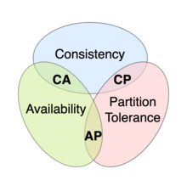
What is NoSQL?
NoSQL, which stands for "Not Only SQL," is a broad category of database systems that differ from traditional relational databases (RDBMS) in their data storage and retrieval mechanisms.
https://en.wikipedia.org/wiki/CAP_theorem

Slide 4
Types of NoSQL Databases
Document Databases: Store data in flexible, JSON-like documents. Examples: MongoDB, Couchbase
Key-Value Stores: Store data as simple key-value pairs. Examples: Redis, Memcached
Wide-Column Stores: Store data in sparse tables with rows and columns. Example: Cassandra
Graph Databases: Store data as a network of interconnected nodes and relationships. Example: Neo4j

Slide 5
What is MongoDB?

Slide 6

What is MongoDB ?
MongoDB is a popular NoSQL database known for its flexibility, scalability, and ease of use. It stores data in flexible, JSON-like documents, making it well-suited for handling unstructured and semi-structured data.

Slide 7
Key Features and Benefits
Flexible Schema: MongoDB's schema-less design allows you to adapt to changing data structures without major database modifications.
Scalability: It can handle massive datasets and high-traffic applications, making it suitable for large-scale deployments.
High Availability: MongoDB offers features like replication and sharding to ensure data redundancy and minimize downtime.
Full-Text Search: Efficiently search for specific terms or phrases
Geospatial Indexing: Store and query location data efficiently, enabling applications like mapping and location-based services.
Aggregation Framework: Perform complex data analysis and transformations directly within the database.

Slide 8
Domains
Content Management Systems (CMS): Store and manage large amounts of content, such as articles, images, and videos.
E-commerce: Handle product catalogs, user data, and order information.
Social Media: Store user profiles, posts, comments, and other social interactions.
IoT: Collect and analyze sensor data from connected devices.
Gaming: Manage player data, game states, and leaderboards.

Slide 9
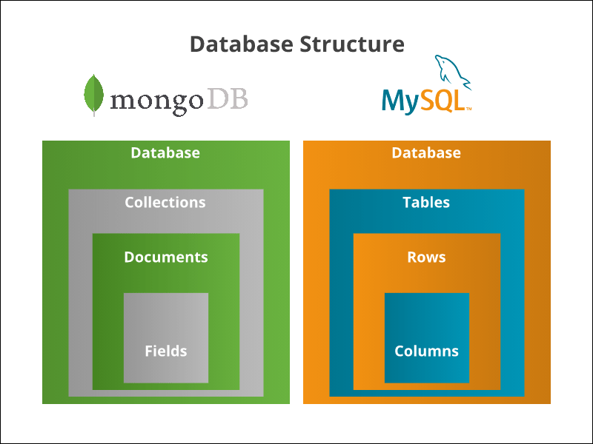
MongoDB Architecture
Documents: JSON-like structures representing data.
Collections: Groups of related documents.
Databases: Contain multiple collections.
Shards: Distributed chunks of data for horizontal scaling.
Replica Sets: Replicated sets of data for high availability.

Slide 10
MongoDB Data Model
Stores data in flexible, JSON-like documents.
{
"_id": ObjectId("5f49c2482c3d190000000000"),
"name": "John Doe",
"age": 30,
"address": {
"street": "123 Main St",
"city": "New York",
"state": "NY"
},
"interests": ["reading", "coding", "traveling"]
}

Slide 11
MongoDB CRUD Operations
Create: db.<collection_name>.insertOne() or db.<collection_name>.insertMany()
Read: db.<collection_name>.find(), db.<collection_name>.findOne()
Update: db.<collection_name>.updateOne(), db.<collection_name>.updateMany()
Delete: db.<collection_name>.deleteOne(), db.<collection_name>.deleteMany()

Slide 12
Setup MongoDB Offline

Slide 13
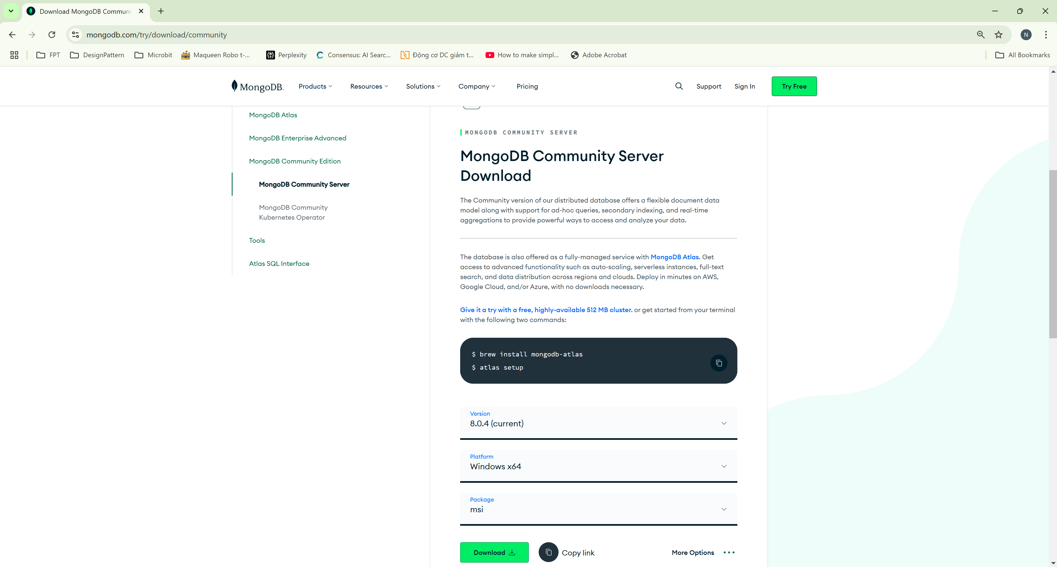
Download MongoDB Community Server

Slide 14
Download MongoDB Community Server

Slide 15
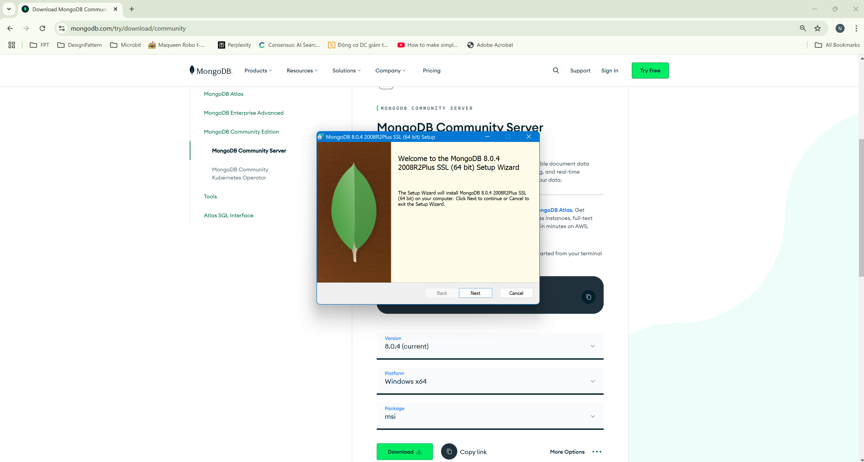
Install MongoDB Offline

Slide 16
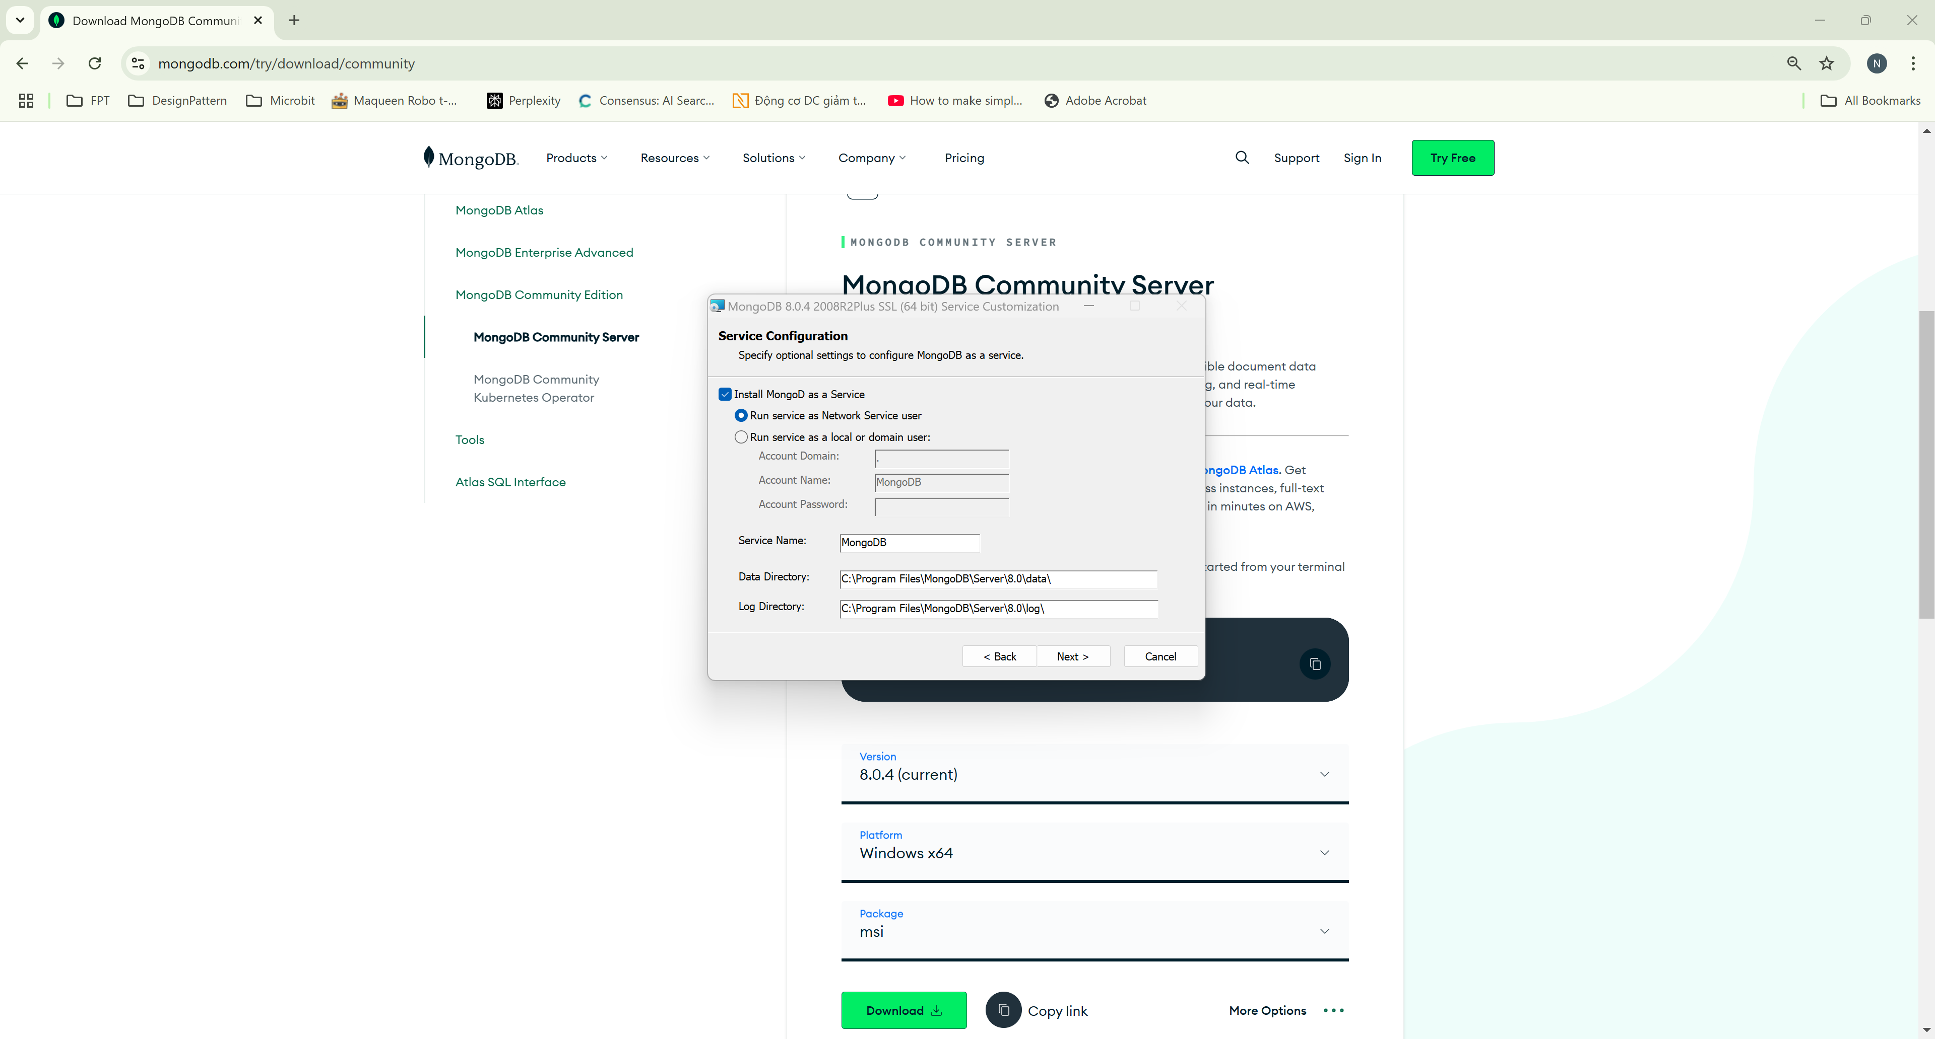
Install MongoDB Offline

Slide 17
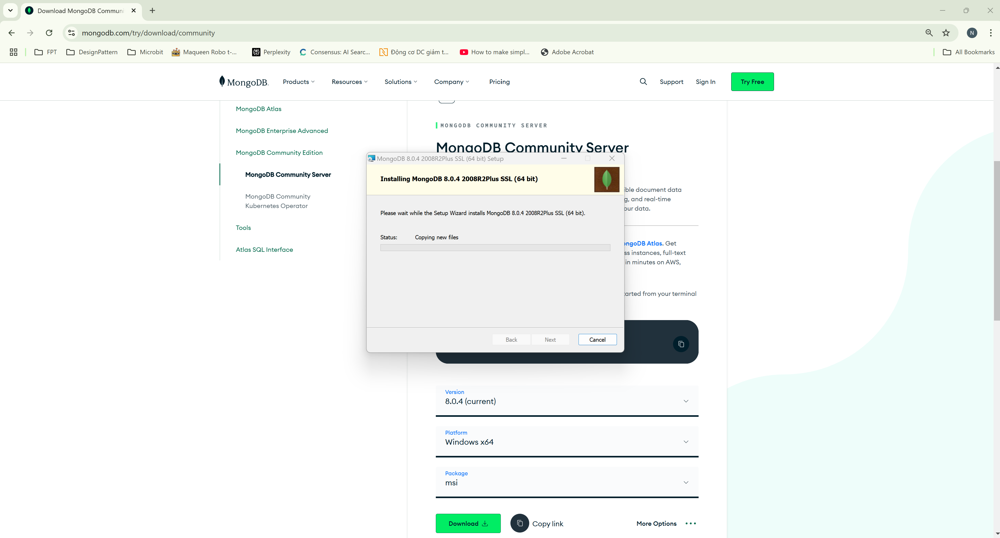
Install MongoDB Offline

Slide 18
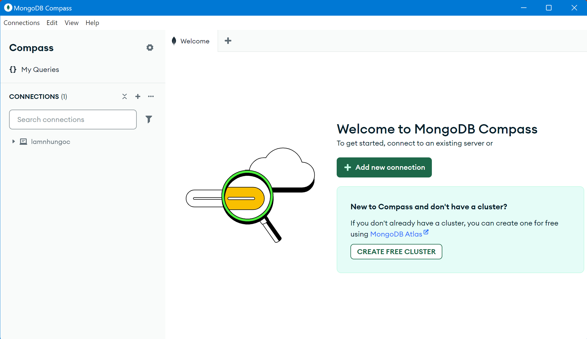
Install MongoDB Offline

Slide 19
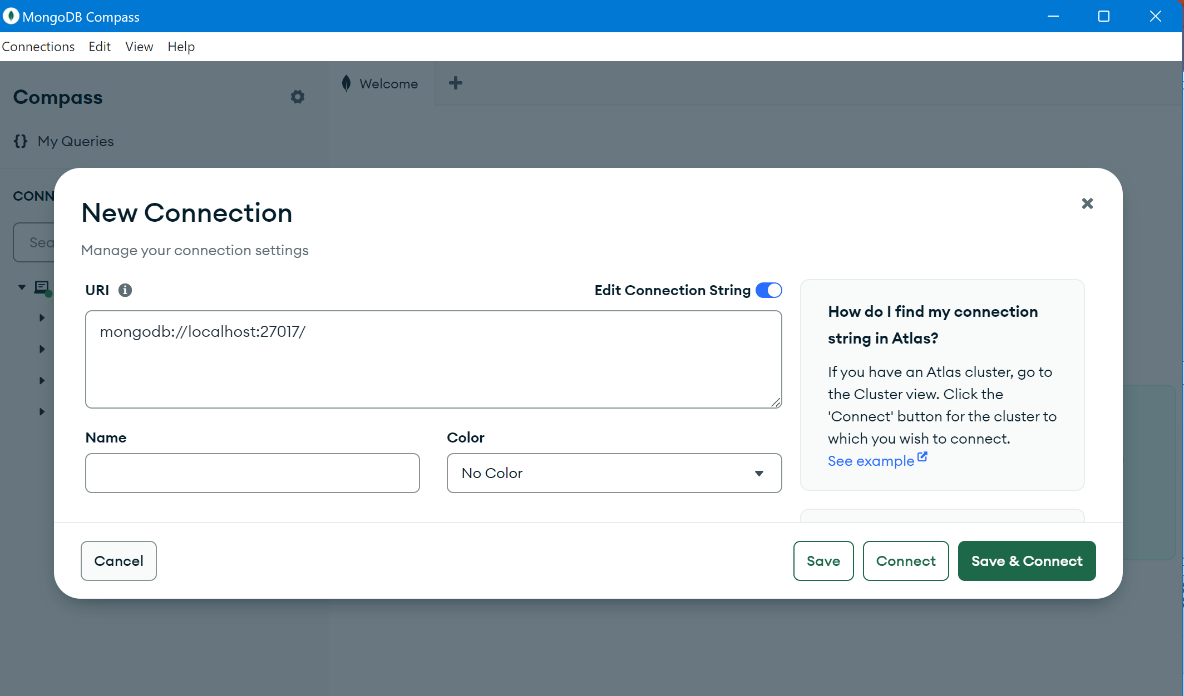
Create Connection

Slide 20
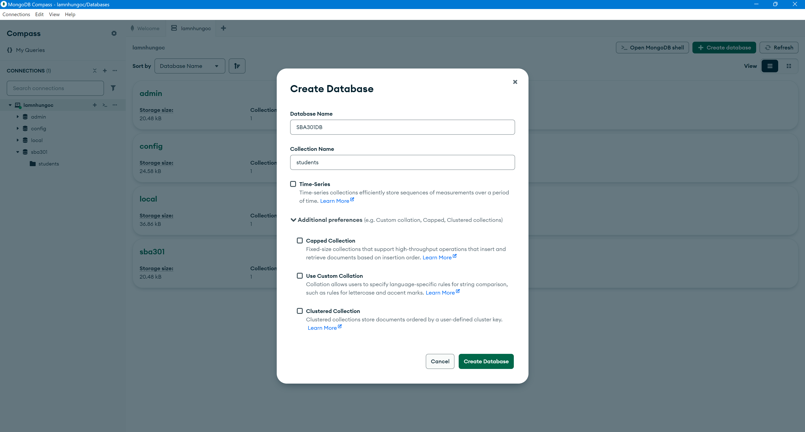
Create database

Slide 21
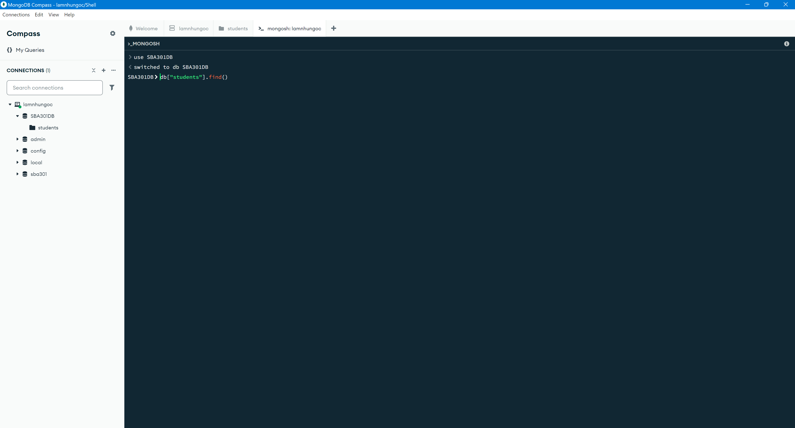
Create database

Slide 22
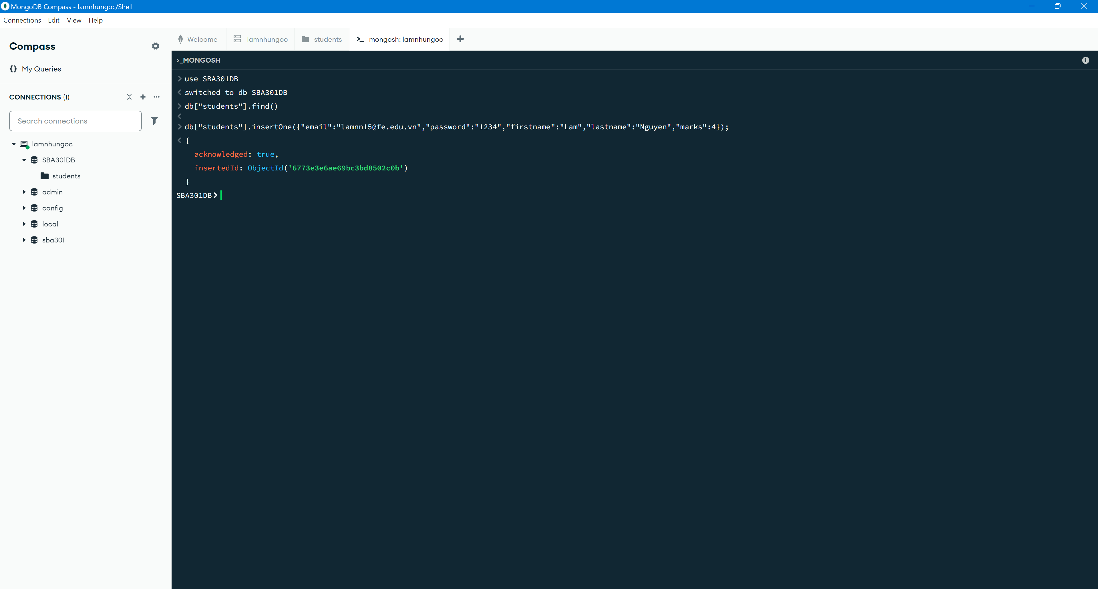
Insert Student

Slide 23
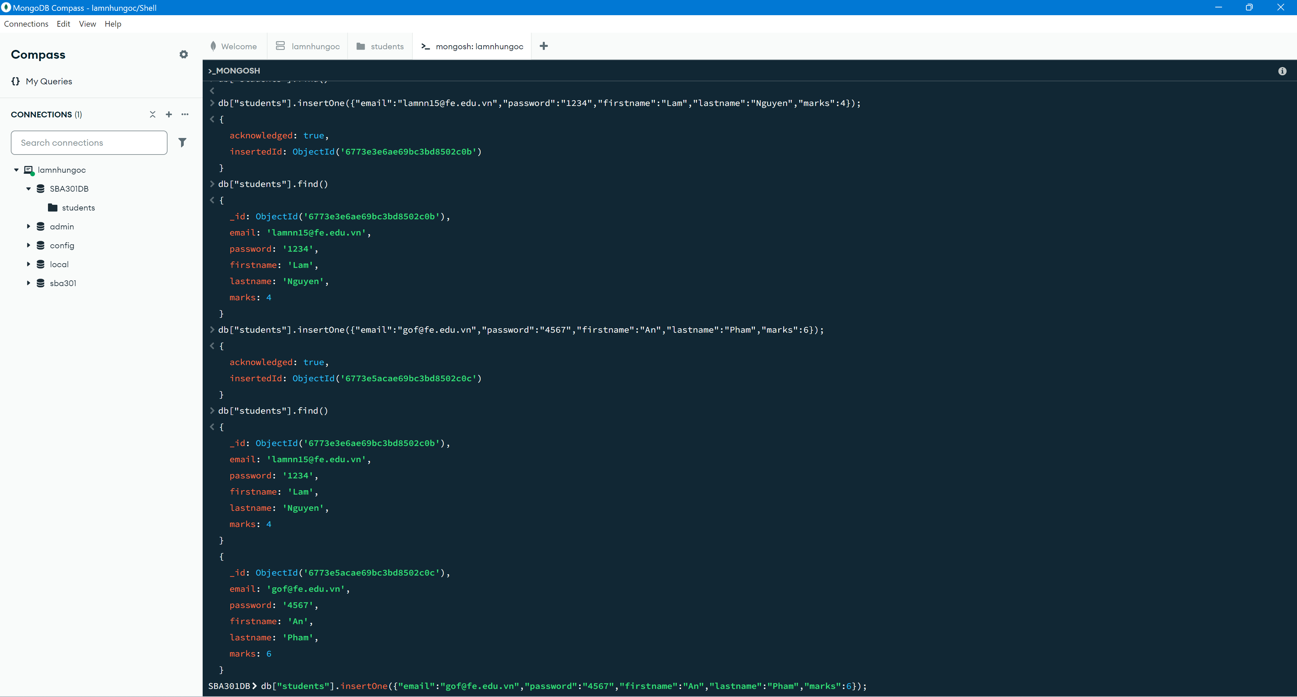
Read Students

Slide 24
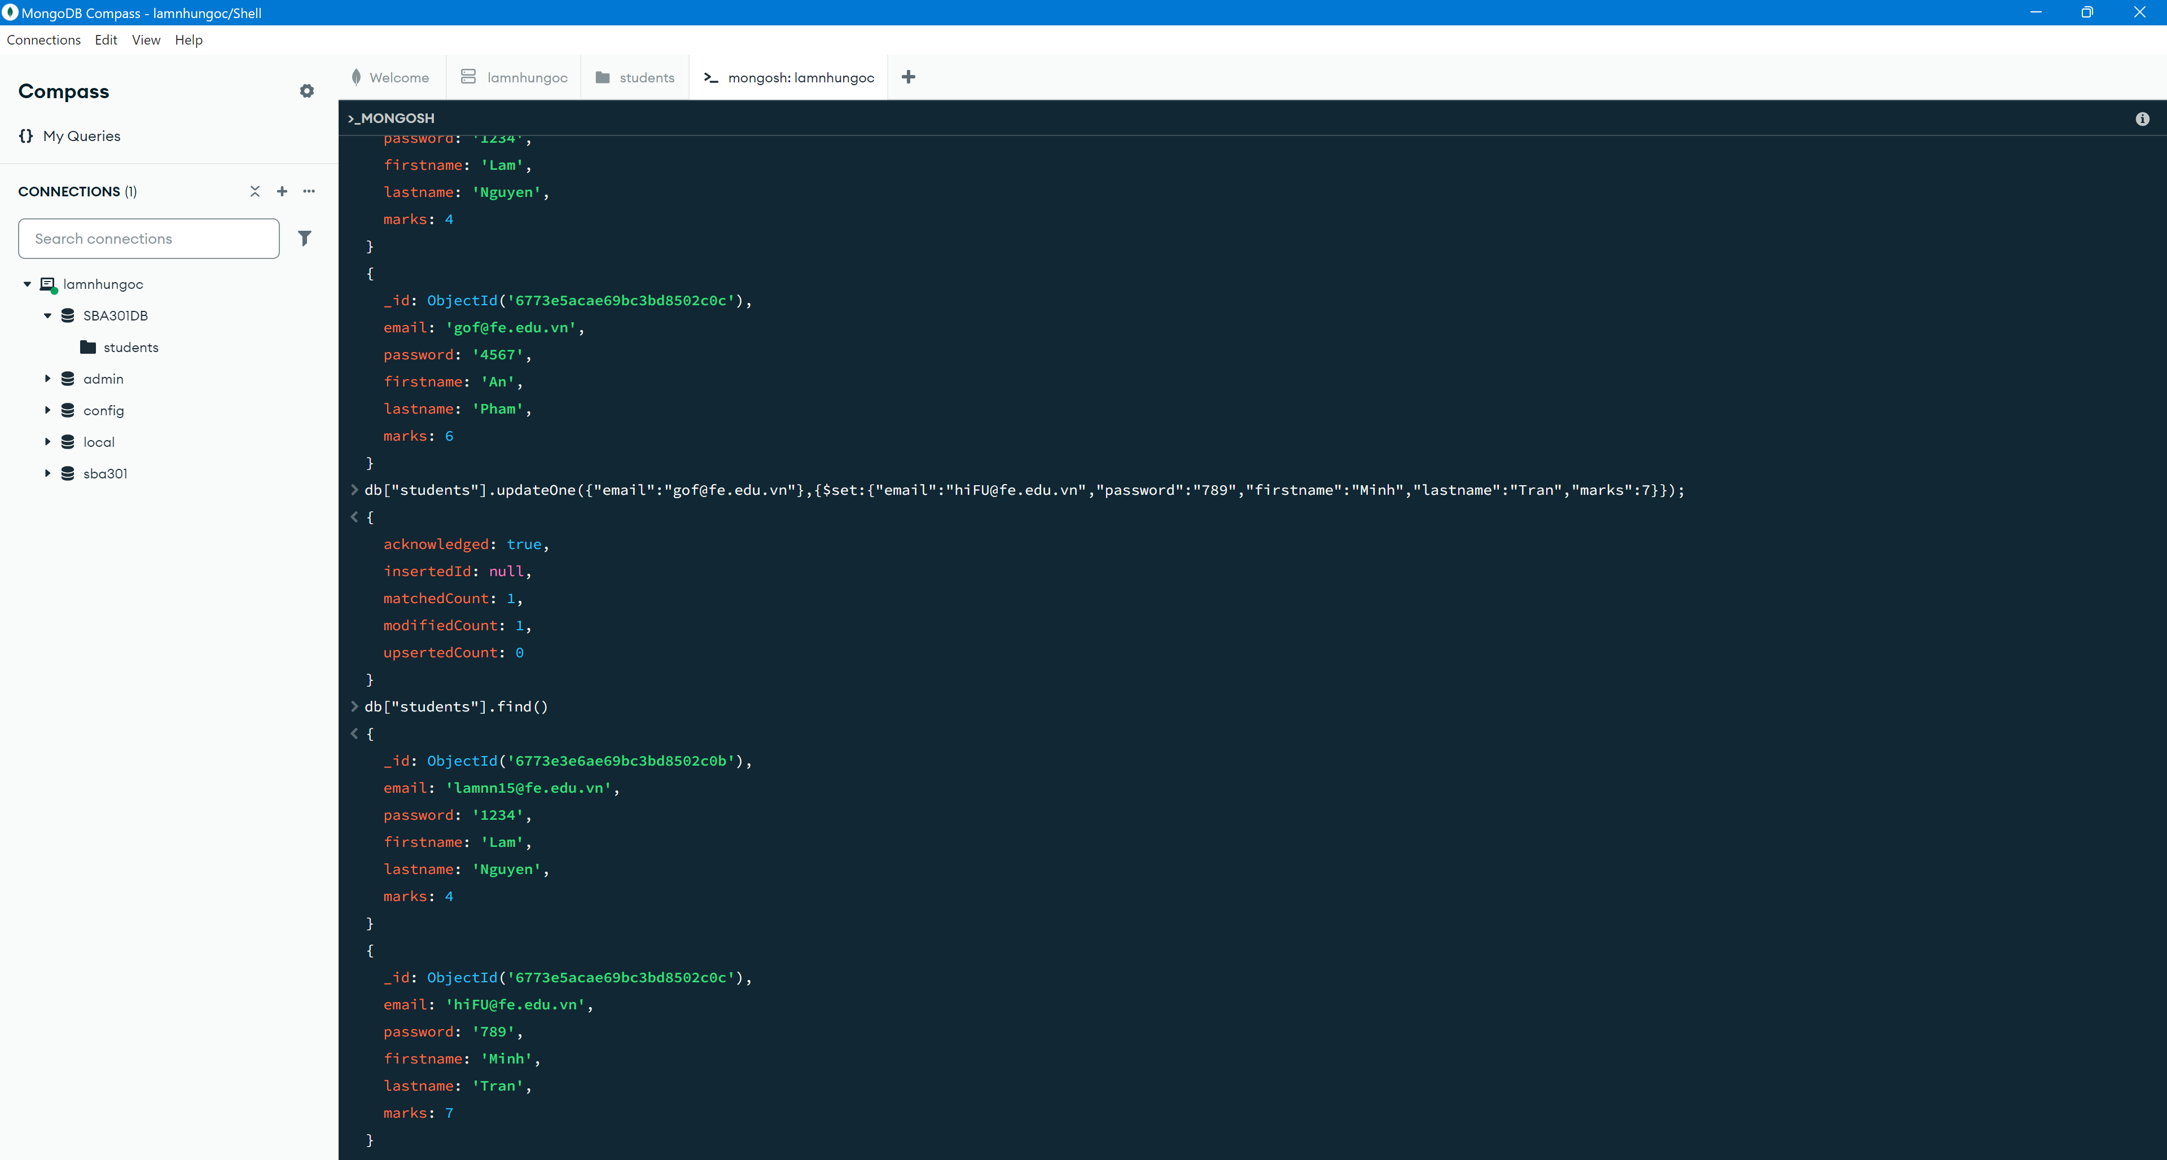
Update a Student

Slide 25
Update a Student

Slide 26
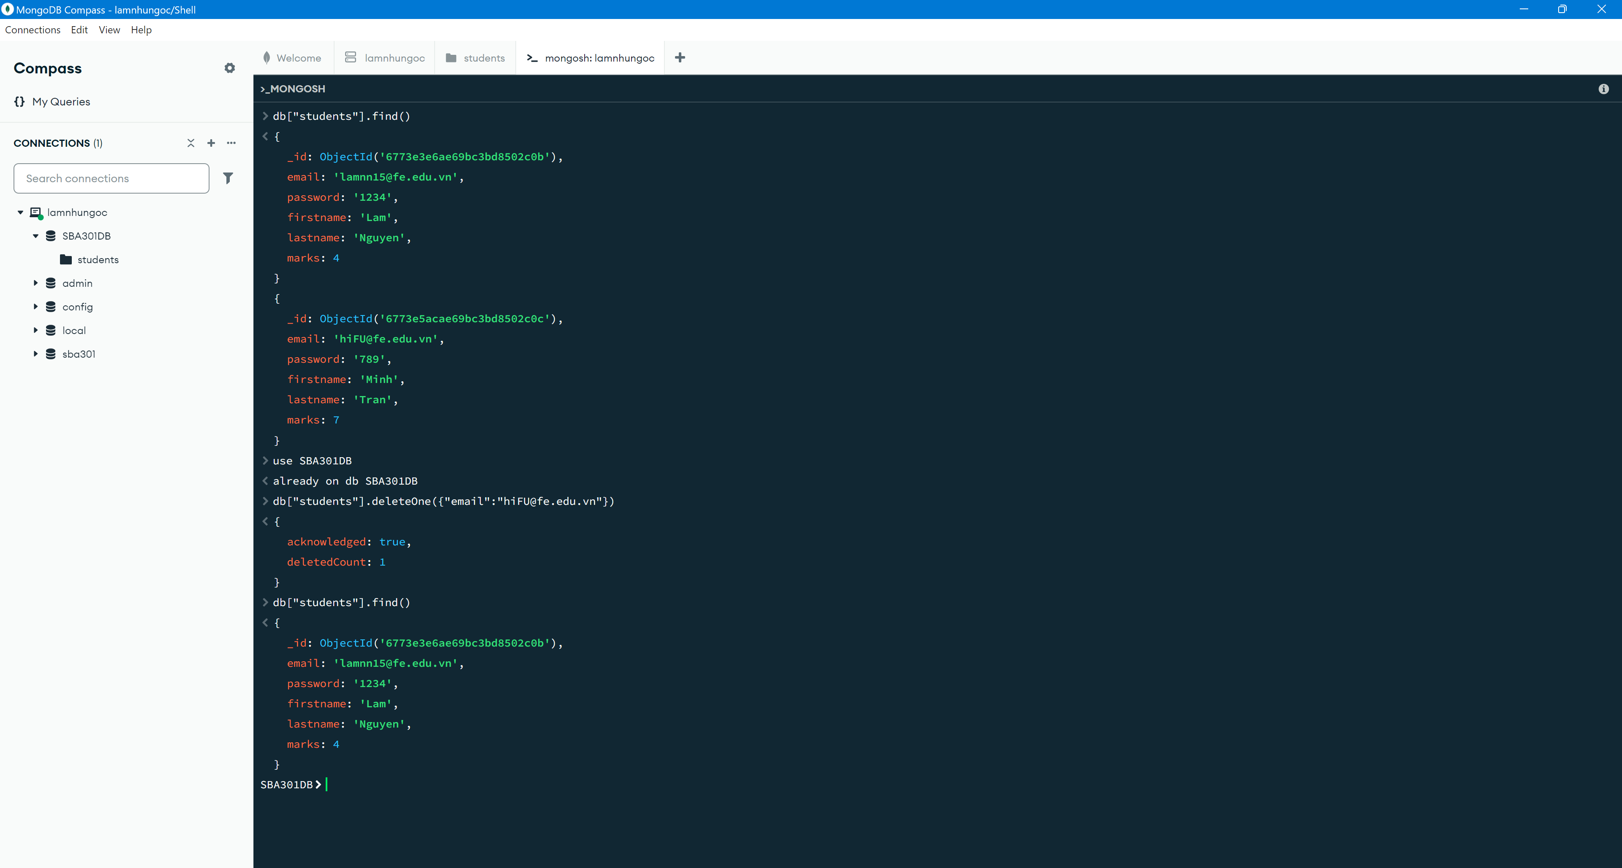
Delete a Student

Slide 27
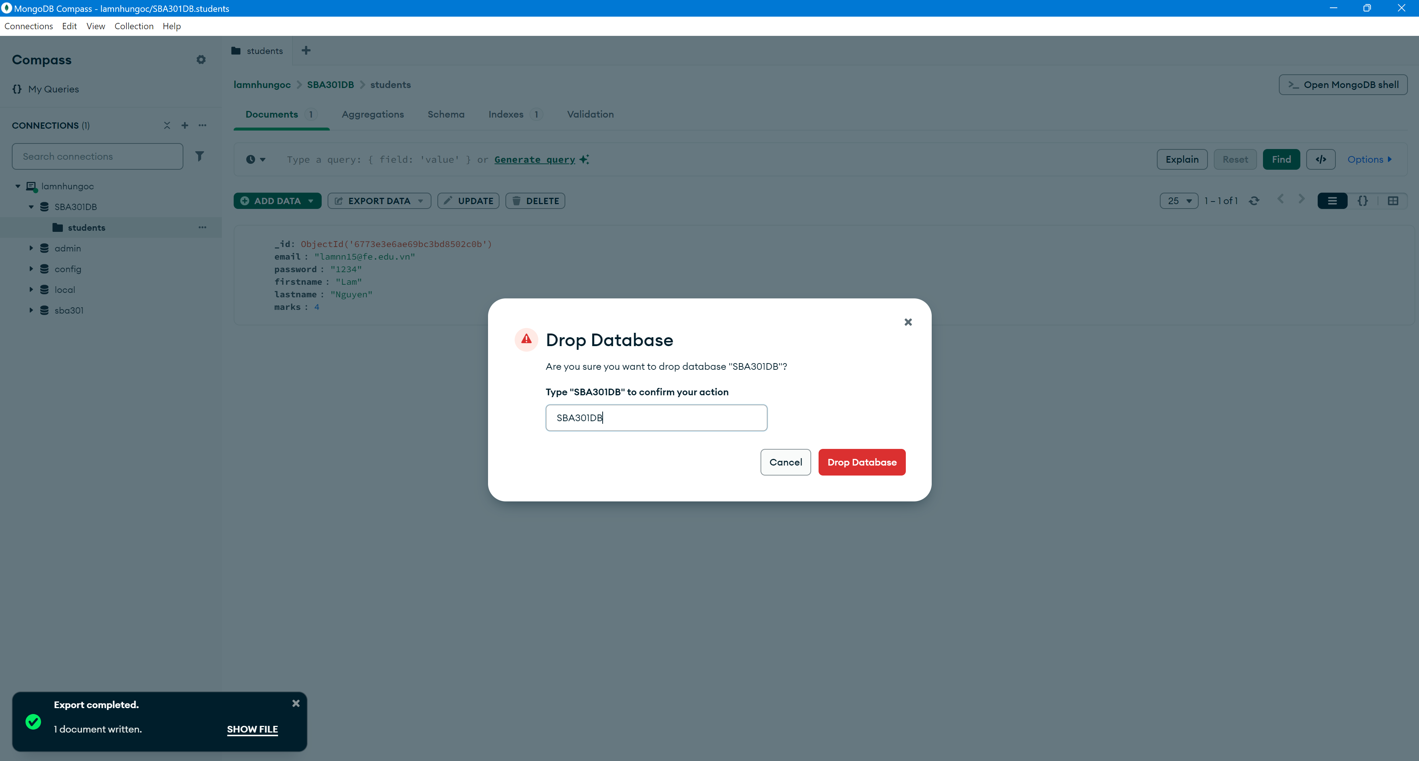
Drop Database

Slide 28
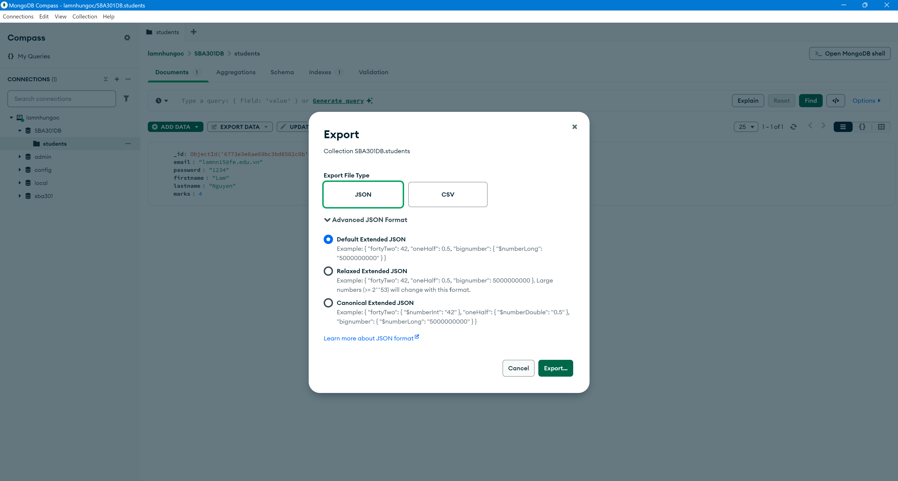
Export collection in MongoDB

Slide 29
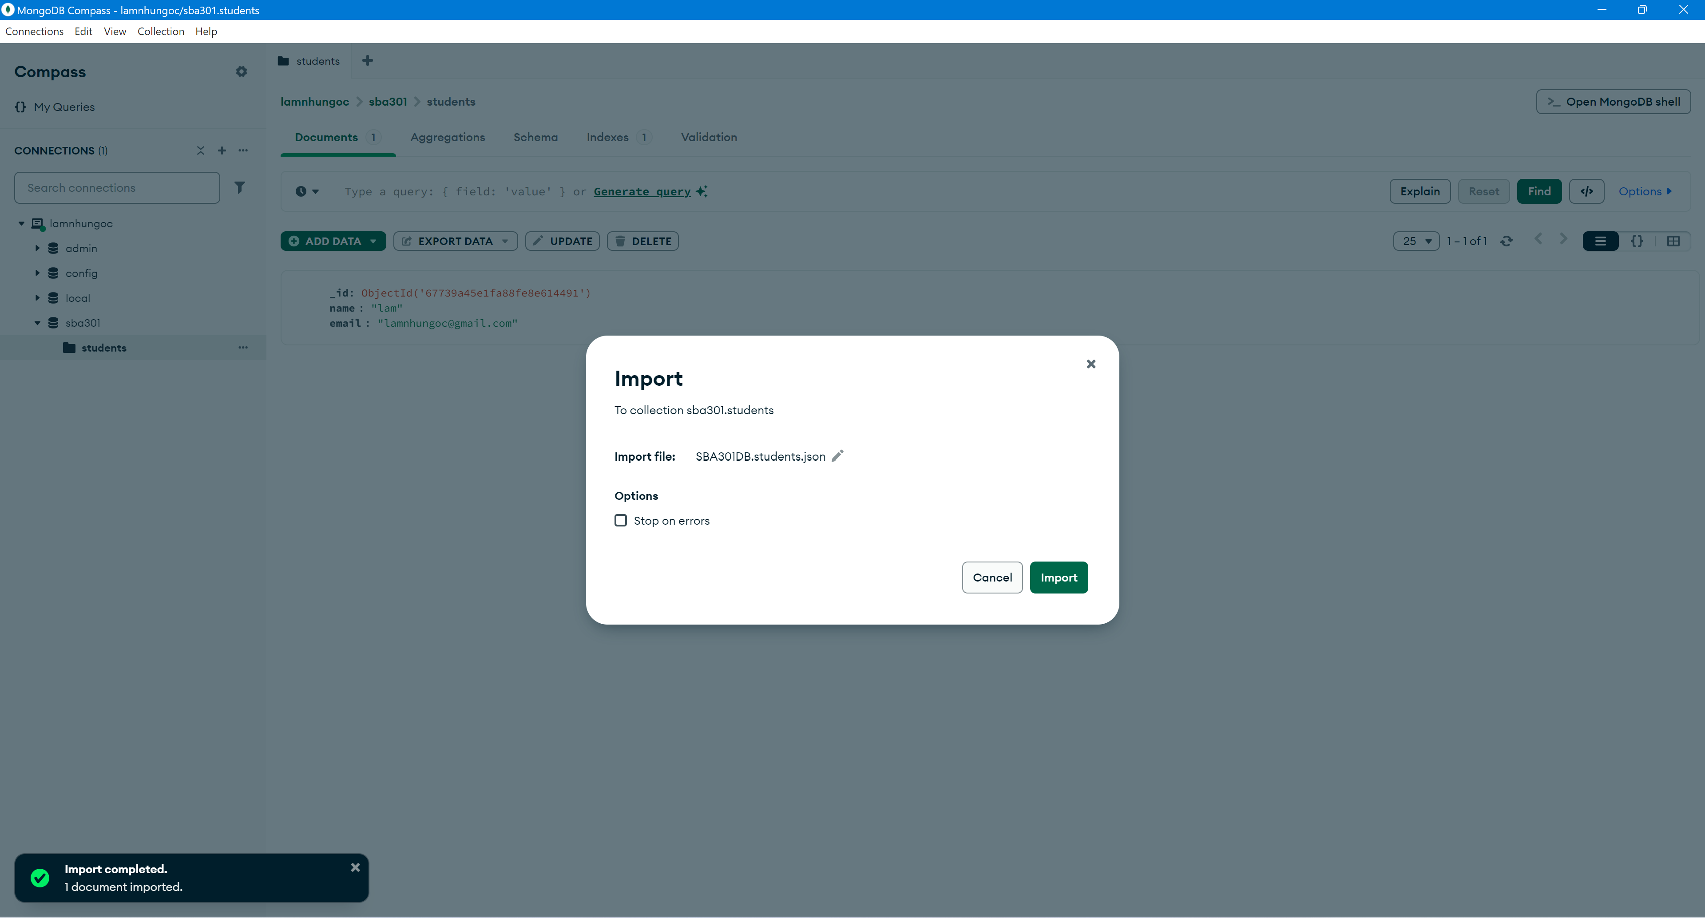
Export collection in MongoDB

Slide 30
MongoDB with Java

Slide 31
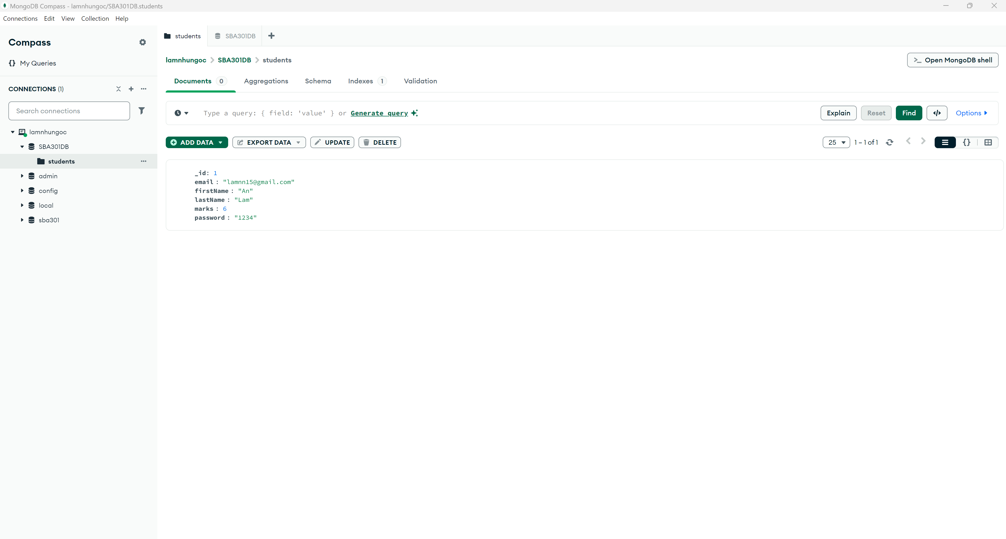
Open MongoDB Compass

Slide 32
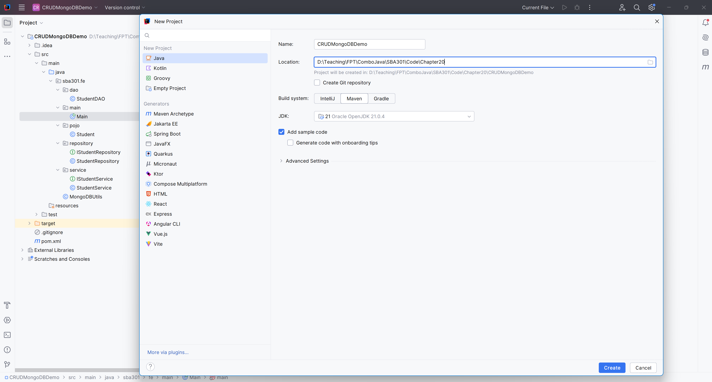
File New Project

Slide 33
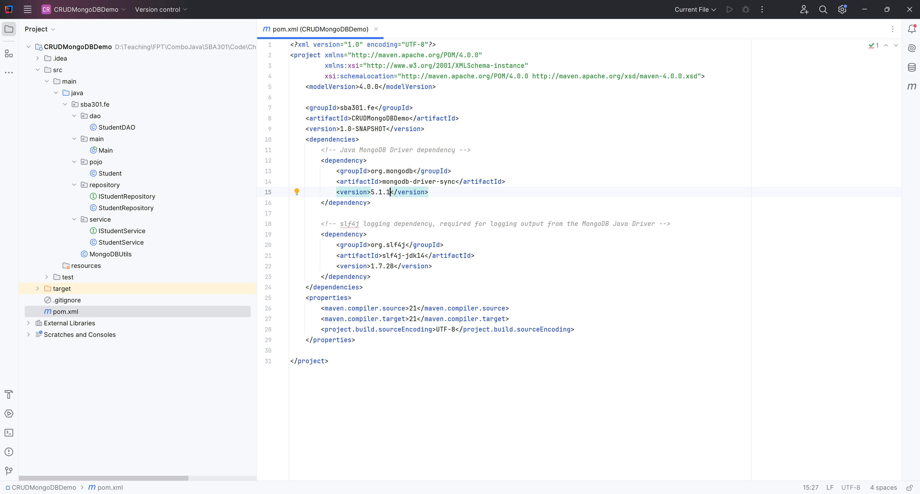
Create the Structure Project

Slide 34
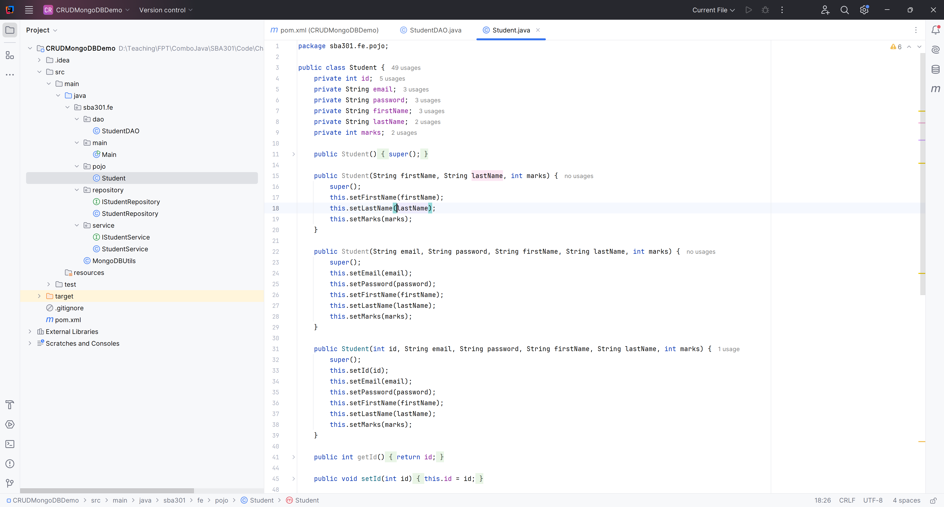
Create Student.java

Slide 35
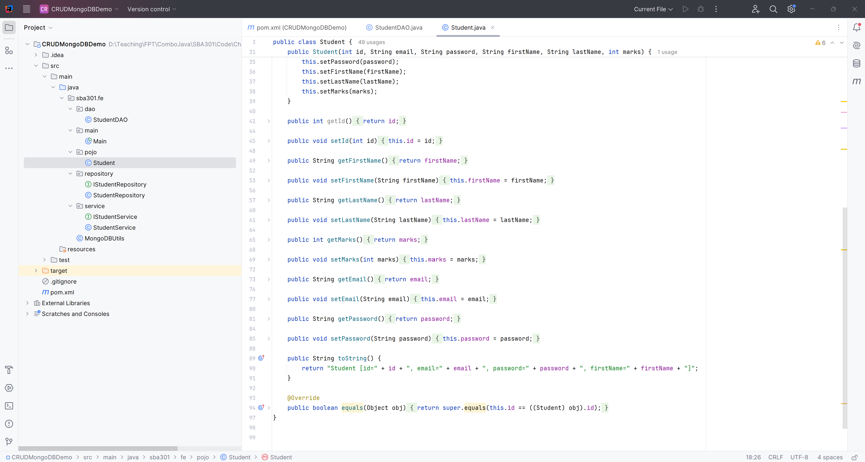
Create Student.java

Slide 36
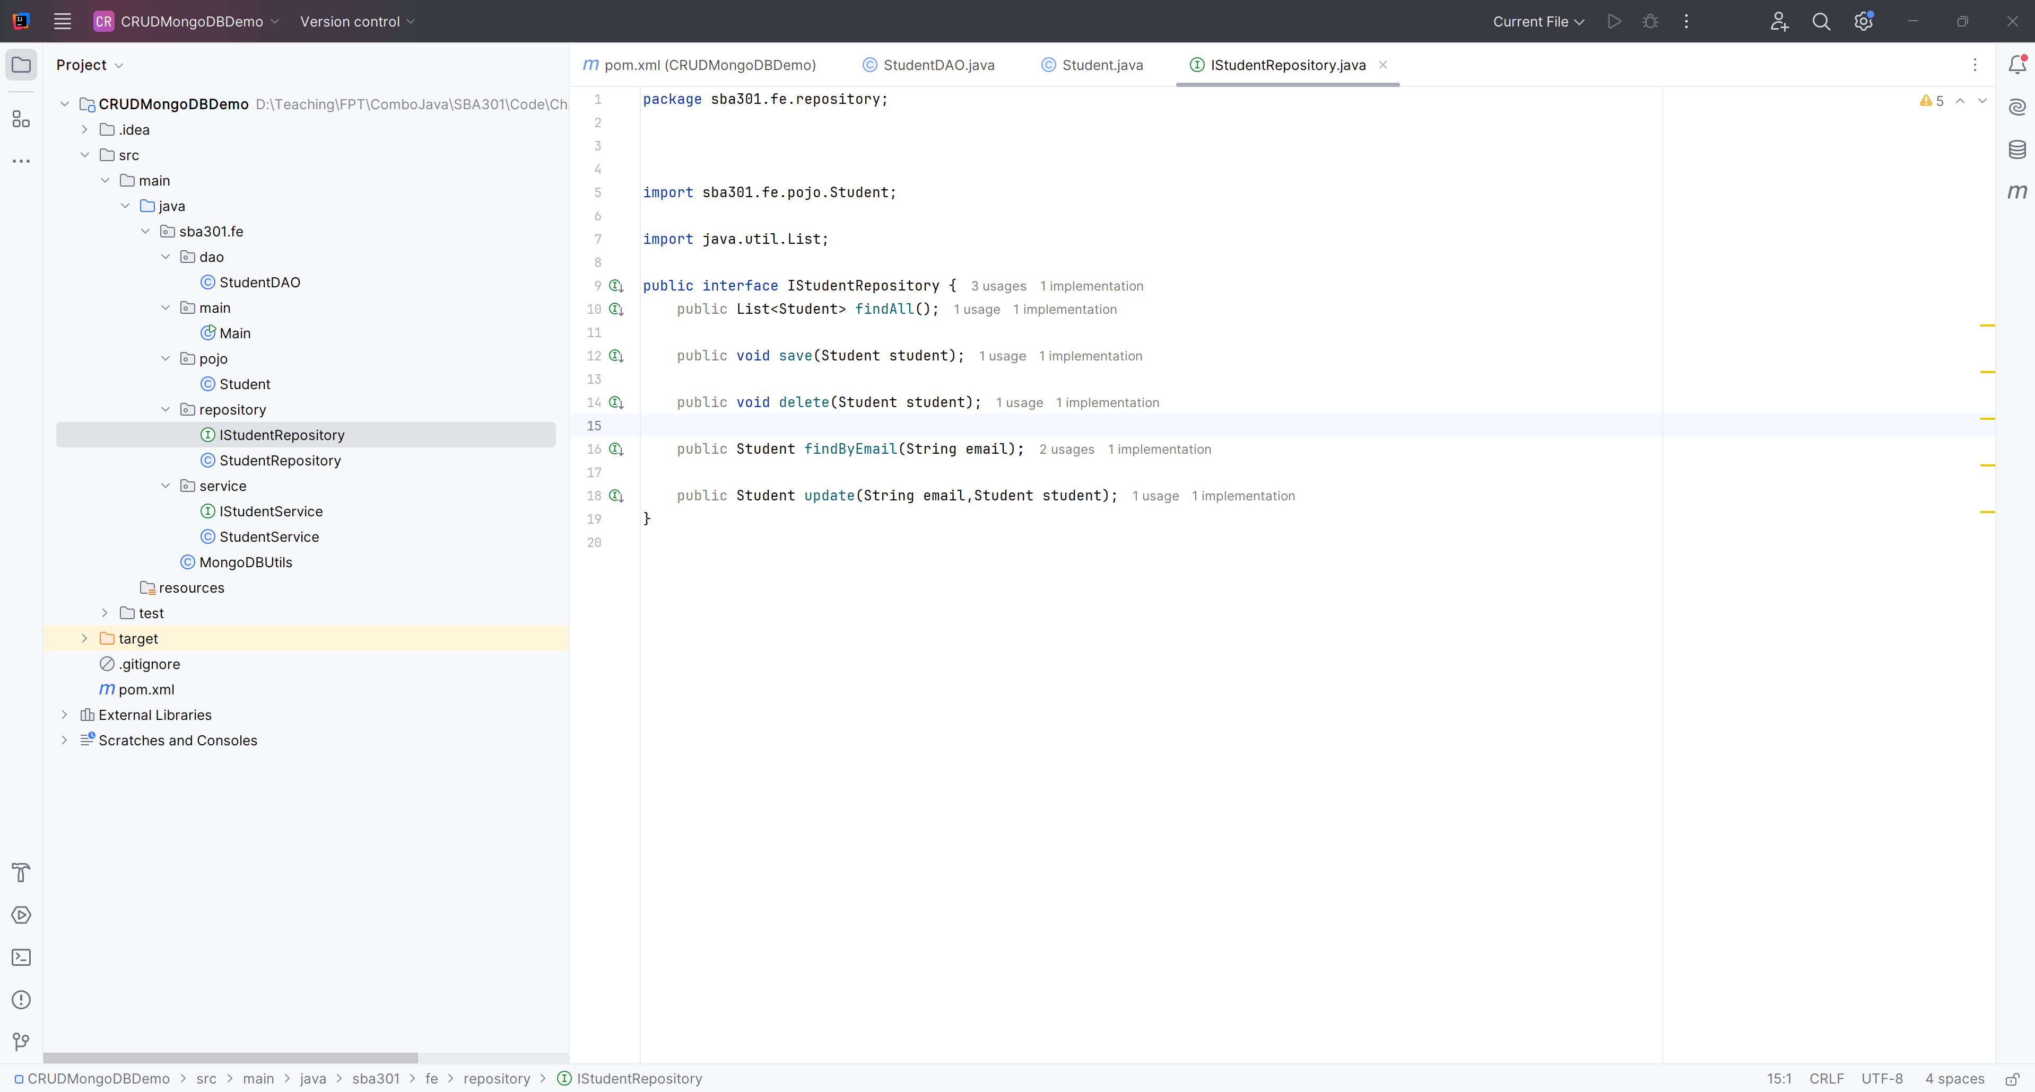
Create IStudentRepository

Slide 37
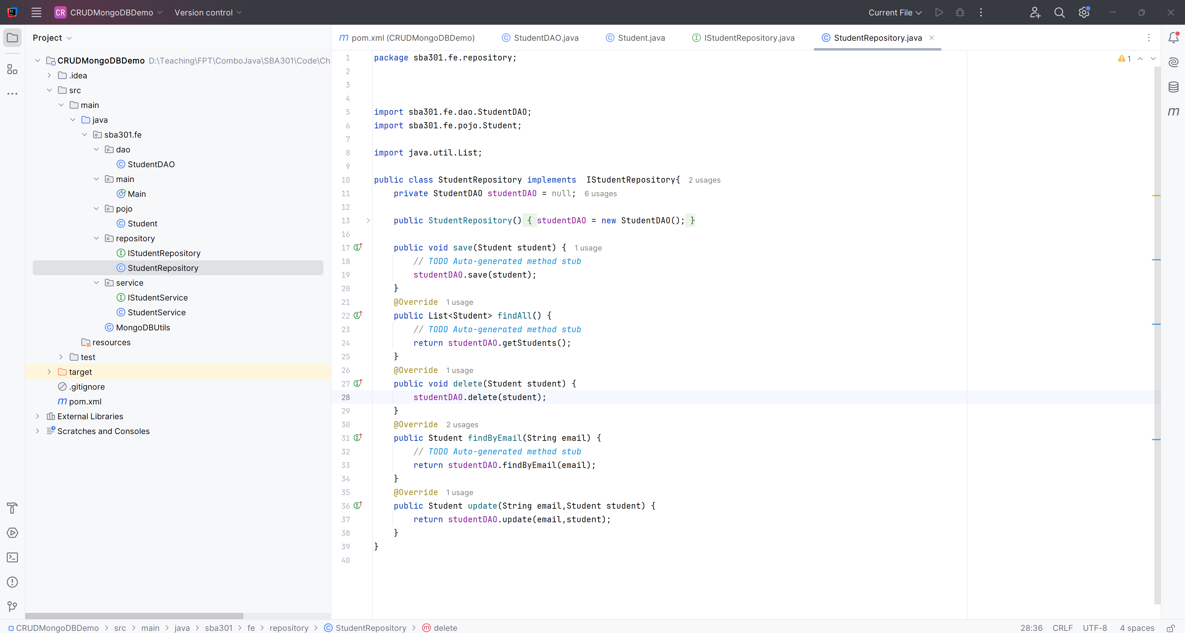
Create StudentRepository

Slide 38
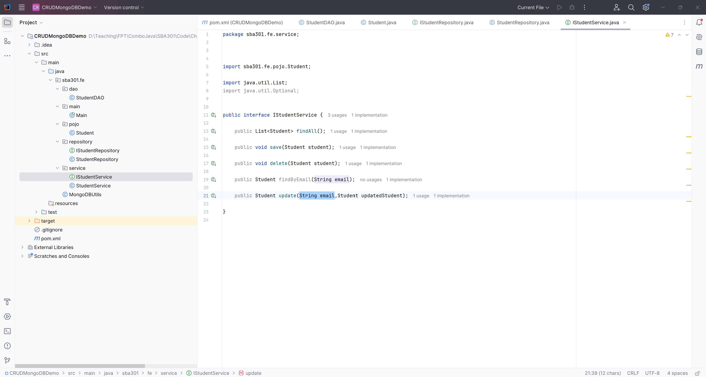
Create IStudentService

Slide 39
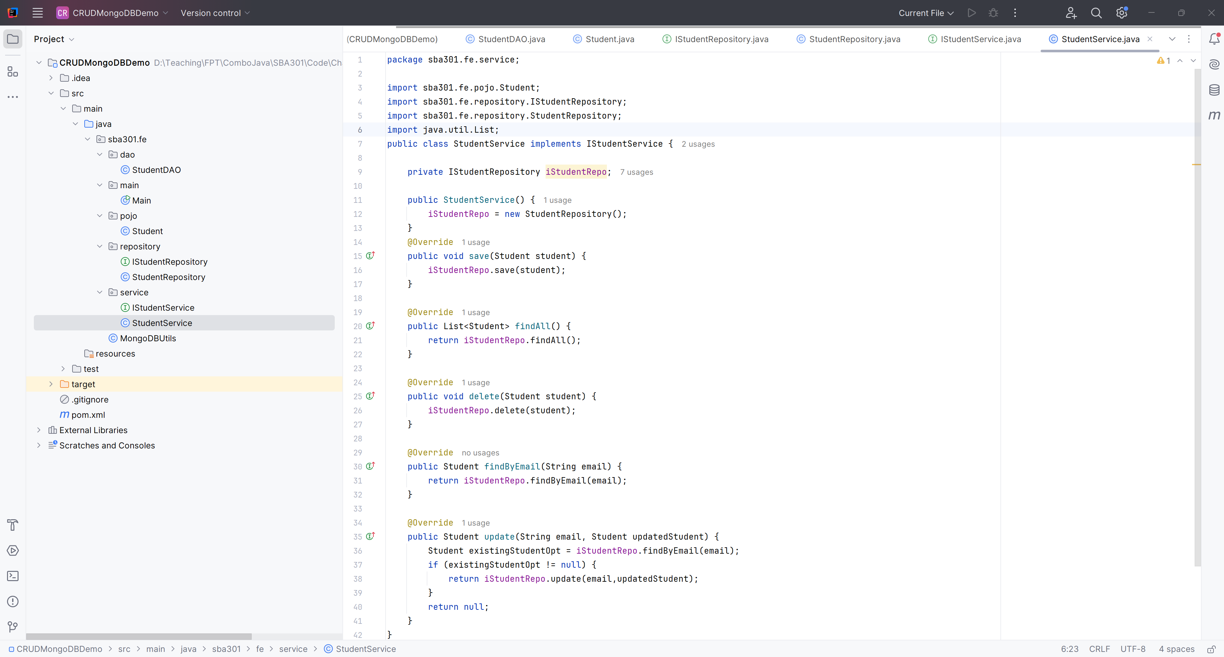
Create StudentService

Slide 40
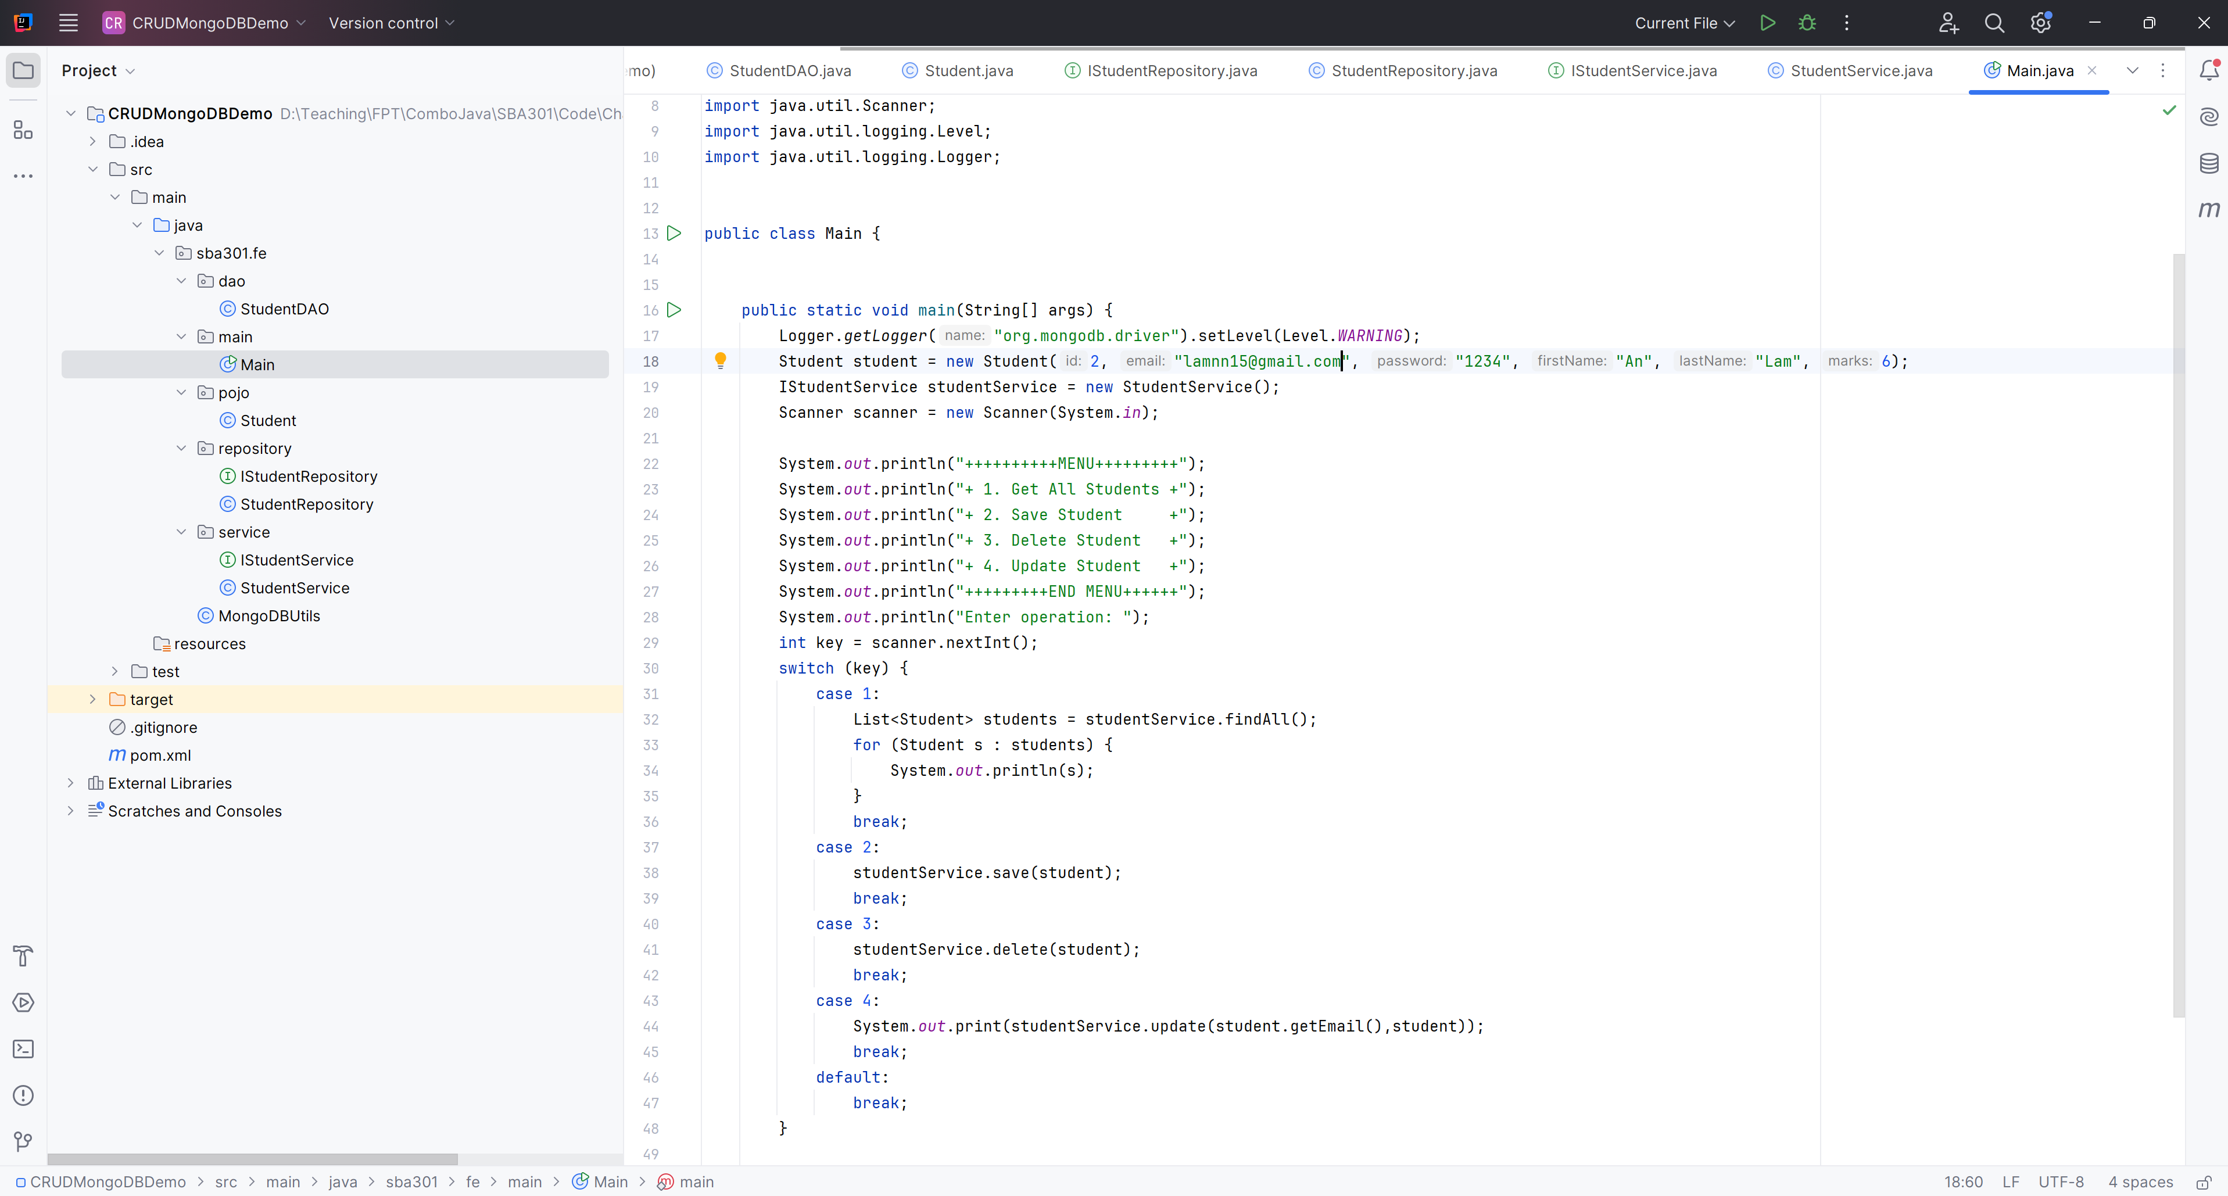
Create Main Function

Slide 41
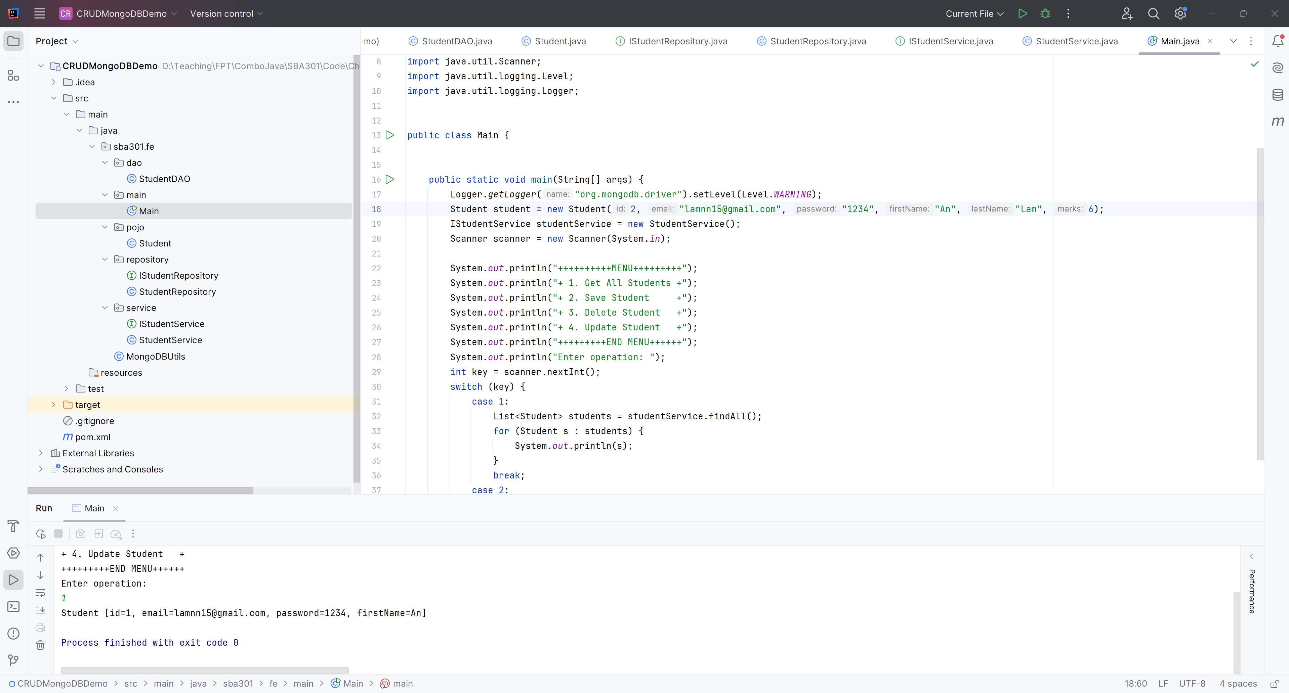
Run Project

Slide 42
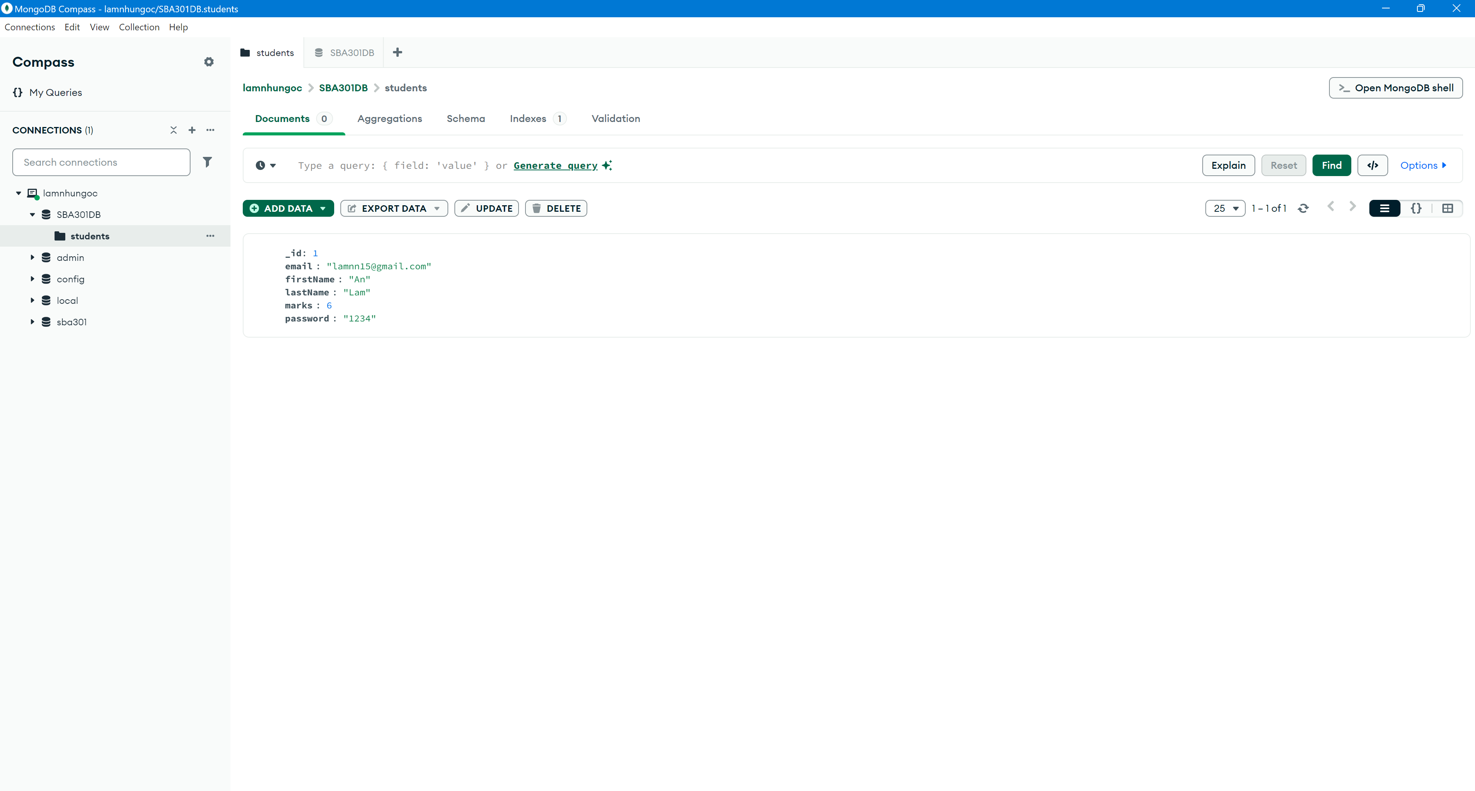
Result

Slide 43
Summary
Concepts were introduced:
Learn about the CAP theorem
Learn about the NoSQL Concepts
Learn about the MongoDB
Implement CRUD (Create, Read, Update, Delete) operations to manage data effectively.

